Slide 1
Dynamic Host Configuration Protocol (DHCP)
June 23, 2015

Slide 2
Agenda
DHCP Introduction
How DHCP Works
Message Flow
DHCP Relay Agents

Slide 3
DHCP Introduction
The Dynamic Host Configuration Protocol (DHCP) is based on the Bootstrap Protocol (BOOTP) and was built from 1993. which provides the framework for passing configuration information to hosts on a TCP/IP network.
DHCP adds the capability to automatically allocate reusable network addresses and configuration options to Internet hosts
DHCP consists of two components:
a protocol for delivering host-specific configuration parameters from a DHCP server to a host
a mechanism for allocating network addresses to hosts.
DHCP is built on a client/server model, where designated DHCP server hosts allocate network addresses and deliver configuration parameters to dynamically configured hosts.

Slide 4
DHCP Introduction
A DHCP infrastructure consists of the following elements:
DHCP servers: computers that offer dynamic configuration of IPv4 addresses and related configuration parameters to DHCP clients.
DHCP clients: network nodes that support the ability to communicate with a DHCP server to obtain a dynamically leased IPv4 address and related configuration parameters.
DHCP relay agents: network nodes (e.g., routers) that listen for broadcast and unicast DHCP messages and relay them between DHCP servers and DHCP clients. Without DHCP relay agents, you would have to install a DHCP server on each subnet that contains DHCP clients.
All DHCP messages are sent using the User Datagram Protocol (UDP).
DHCP servers listen on UDP port 67.
DHCP client listen on UDP port 68.
DHCP relay agents listen on both UDP ports

Slide 5
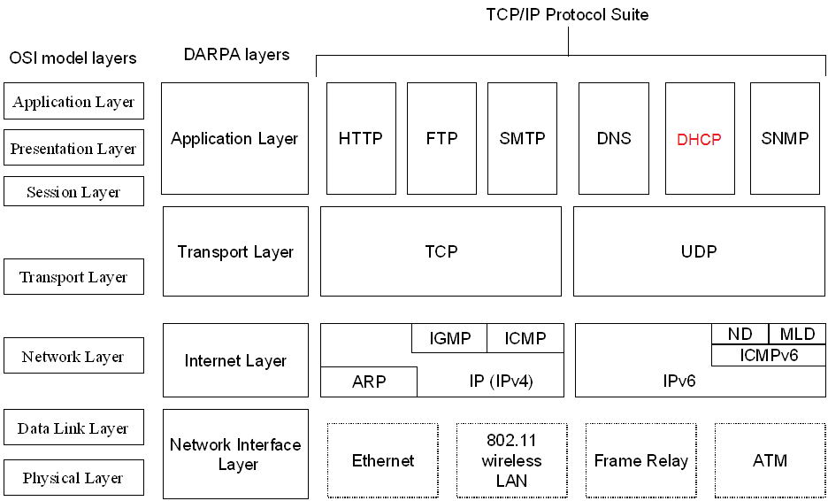
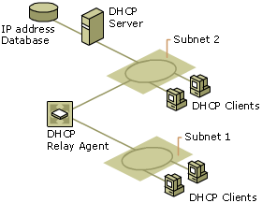
DHCP Introduction

Slide 6
DHCP Introduction
Benefits of using DHCP
Users no longer need to acquire IPv4 address configurations from a network administrator to properly configure TCP/IP.
When a DHCP client is started, it automatically receives an IPv4 address configuration that is correct for the attached subnet from a DHCP server.
When the DHCP client moves to another subnet, it automatically obtains a new IPv4 address configuration for that subnet.
The DHCP server supplies all of the necessary configuration information to all DHCP clients.
As long as the DHCP server has been correctly configured, all DHCP clients of the DHCP server are configured correctly

Slide 7
How DHCP Work?
Each time a DHCP client starts:
it requests IPv4 addressing information from a DHCP server, including:
IPv4 address
Subnet mask
Additional configuration parameters:
default gateway address,
Domain Name System (DNS) server addresses,
DNS domain name,
Windows Internet Name Service (WINS) server addresses.
it uses the alternate configuration when it cannot contact a DHCP server (Windows)
Automatic Private IP Addressing (APIPA) address or an alternate configuration that has been configured manually

Slide 8
How DHCP Work?
When a DHCP server receives a request:
it selects an available IPv4 address from a pool of addresses defined in its database (along with other configuration parameters) and offers it to the DHCP client.
if the client accepts the offer, the IPv4 addressing information is leased to the client for a specified period of time

Slide 9
Message Flow
Server A
Client
Server B
Client attempts to discover available DHCP servers
DHCPDISCOVER
DHCPDISCOVER
Servers reply with offers
DHCPOFFER
DHCPOFFER
Client collects offers and decides which offer to accept
Client broadcasts request for one of the received offers
DHCPREQUEST
DHCPREQUEST
Server acknowledges client’s use of IP address
Configuration complete
DHCPACK
Graceful shutdown
Client explicitly releases use of IP address
DHCPRELEASE

Slide 10
Message Flow
Message Type | Description
DHCPDiscover | The first time a DHCP client computer attempts to log on to the network, it requests IP address information from a DHCP server by broadcasting a DHCPDiscover packet. The source IP address in the packet is 0.0.0.0 because the client does not yet have an IP address. The message is either 342 or 576 bytes long—older versions of Windows use a longer message frame.
DHCPOffer | Each DHCP server that receives the client DHCPDiscover packet responds with a DHCPOffer packet containing an unleased IP address and additional TCP/IP configuration information, such as the subnet mask and default gateway. More than one DHCP server can respond with a DHCPOffer packet. The client will accept the first DHCPOffer packet it receives. The message is 342 bytes long.
DHCPRequest | When a DHCP client receives a DHCPOffer packet, it responds by broadcasting a DHCPRequest packet that contains the offered IP address, and shows acceptance of the offered IP address. The message is either 342 or 576 bytes long, depending on the length of the corresponding DHCPDiscover message.
DHCPAcknowledge (DHCPAck) | The selected DHCP server acknowledges the client DHCPRequest for the IP address by sending a DHCPAck packet. At this time the server also forwards any optional configuration parameters. Upon receipt of the DHCPAck, the client can participate on the TCP/IP network and complete its system startup. The message is 342 bytes long.
DHCPNak | If the IP address cannot be used by the client because it is no longer valid or is now used by another computer, the DHCP server responds with a DHCPNak packet, and the client must begin the lease process again. Whenever a DHCP server receives a request for an IP address that is invalid according to the scopes that it is configured with, it sends a DHCPNak message to the client.
DHCPDecline | If the DHCP client determines the offered configuration parameters are invalid, it sends a DHCPDecline packet to the server, and the client must begin the lease process again.
DHCPRelease | A DHCP client sends a DHCPRelease packet to the server to release the IP address and cancel any remaining lease.
DHCPInform | DHCPInform is a new DHCP message type, defined in RFC 2131, used by computers on the network to request and obtain information from a DHCP server for use in their local configuration. When this message type is used, the sender is already externally configured for its IP address on the network, which may or may not have been obtained using DHCP. This message type is not currently supported by the DHCP service provided in earlier versions of Windows NT Server and may not be recognized by third-party implementations of DHCP software.

Slide 11
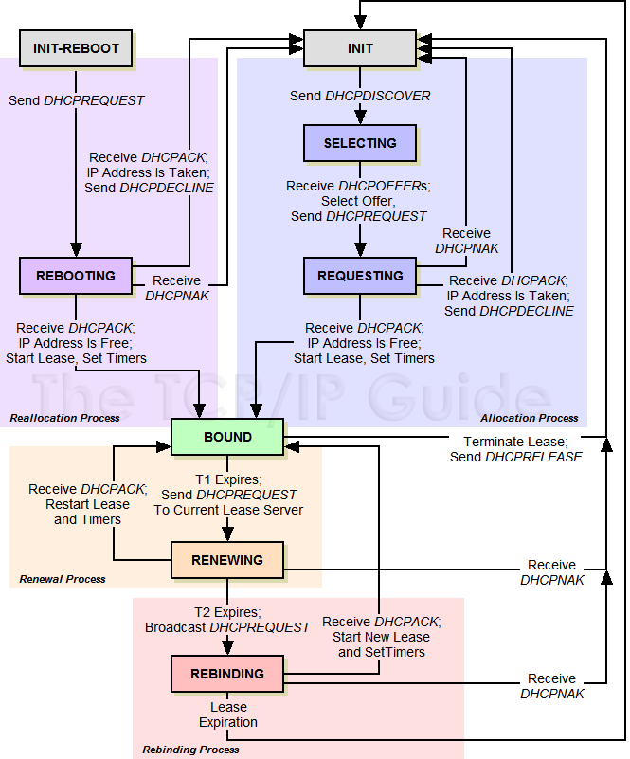
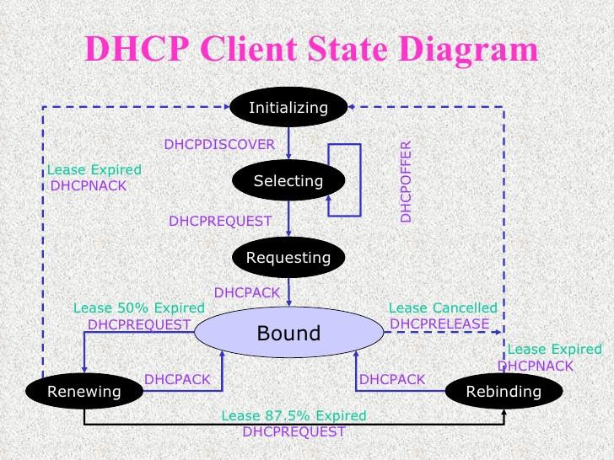
Message Flow
DHCP Client State Diagram
Notes:
The Initializing State
When DHCP client is in the Initializing state
its IPv4 address is 0.0.0.0 (unspecified address)
it tries to obtain an IPv4 address configuration by broadcasting a DHCPDiscover message from UDP port 67 to UDP port 68.
the source IPv4 address is 0.0.0.0
the destination is 255.255.255.255
DHCPDiscover message contains the DHCP client’s media access control (MAC) address and computer name.
If a DHCP server is on the DHCP client's subnet, the server receives the broadcast DHCPDiscover message.
If no DHCP server on the DHCP client’s subnet, a DHCP relay agent on the DHCP client’s subnet receives the broadcast DHCPDiscover message and relays it as a unicast DHCPDiscover message from the DHCP relay agent to one or more DHCP servers
Before forwarding the original DHCPDiscover message, the DHCP relay agent makes the following changes:
Increments the Hops field in the DHCP header
If the value of the Giaddr (Gateway IP Address) field in the DHCP header is 0.0.0.0 (as set by the originating DHCP client), changes the value to the IPv4 address of the interface on which the DHCPDiscover message was received.
Changes the source IPv4 address of the DHCPDiscover message to an IPv4 address assigned to the DHCP relay agent.
Changes the destination IPv4 address of the DHCPDiscover message to the unicast IPv4 address of a DHCP server.
The Selecting State
All DHCP servers that receive DHCPDiscover message and have a valid IPv4 address configuration for the DHCP client respond with a DHCPOffer message from UDP port 68 to UDP port 67.
In the Selecting state, the DHCP client can select from the set of IPv4 address configurations that the DHCP servers offered.
The DHCP server uses the following process to determine the scope from which an IPv4 address for the DHCP client is to be selected and included in the DHCPOffer message:
If Giaddr is 0.0.0.0, set Giaddr to IPv4 address of the interface on which the DHCPDiscover message was received.
For each scope, perform a bit-wise logical AND of Giaddr with subnet mask of the scope. If the result matches the subnet prefix of the scope, the DHCP server allocates an IPv4 address from that scope.
If the DHCPDiscover message was received as a unicast, the DHCP server sends the DHCPOffer message to the DHCP relay agent.
The DHCP relay agent uses the Giaddr value to determine the interface to use to forward the DHCPOffer message
If DHCPOffer needs to be sent to client as unitcast message: DHCP server/relay agent uses the offered IPv4 address as the destination IPv4 address and the client's MAC address as the destination MAC address
The DHCPOffer messages contain the DHCP client’s MAC address, an offered IPv4 address, appropriate subnet mask, a server identifier (IPv4 address of the offering DHCP server), the length of the lease, and other configuration parameters
The Requesting State
In the Requesting state, DHCP client requests a specific IP address configuration by broadcasting a DHCPRequest message from UDP port 67 to UDP port 68
source IPv4 address is 0.0.0.0
destination IPv4 address is 255.255.255.255.
DHCPRequest message contains IPv4 address of DHCP server if IPv4 address configuration of the DHCP client was just obtained with a DHCPDiscover/DHCPOffer message exchange
the specified DHCP server will respond and all other DHCP servers to retract their DHCP offers to the client
DHCPRequest message doesn't contain IPv4 address of DHCP server if IPv4 address configuration of the client was previously known (e.g., the computer was restarted and is trying to renew its lease on its previous address)
when restarting, the DHCP client can renew its IPv4 address configuration from any DHCP server.
If DHCP client does not have a DHCP server on its subnet, a DHCP relay agent on its subnet receives the broadcast DHCPRequest message and relays it as a unicast DHCPRequest message from the DHCP relay agent to one or more DHCP servers.
The Bound State
In the Bound state, DHCP client receives confirmation that DHCP server has allocated and reserved the offered IPv4 address configuration to the DHCP client.
The DHCP server that leased the requested IPv4 address responds with either a successful acknowledgment (DHCPAck) or a negative acknowledgment (DHCPNak).
The DHCP server sends DHCPAck message from UDP port 68 to UDP port 67, and the message contains a lease period for the requested IPv4 address configuration as well as any additional configuration parameters.
If the DHCPRequest message was received as a unicast, the DHCP server sends the DHCPAck message to the DHCP relay agent.
The DHCP relay agent uses the Giaddr value to determine the interface to use to forward the DHCPAck message
If DHCPAck needs to be sent to client as unitcast message: DHCP server/relay agent uses the offered IPv4 address as the destination IPv4 address and the client's MAC address as the destination MAC address
When receiving DHCPAck message, DHCP client verifies that the IPv4 address is unique on the subnet.
If the IPv4 address is not unique, DHCP client broadcasts a DHCPDecline message and returns to the Initializing state.
When the DHCP server receives the DHCPDecline message (as broadcast msg from client or unicast msg from relay agent), it marks the offered IPv4 address as unusable.
A DHCP server sends a DHCPNak message if:
The client is trying to lease its previous IPv4 address and the IPv4 address is no longer available.
The IPv4 address is invalid because the client has been physically moved to a different subnet.
The DHCPNak message is forwarded to the DHCP client's subnet using the same method as the DHCPAck message.
When the DHCP client receives a DHCPNak, it returns to the Initializing state.
The Renewing State
In the Renewing state, DHCP client is attempting to renew the lease on its IPv4 address configuration.
By default, DHCP clients first try to renew their lease when 50% of the lease time has expired.
To renew its lease, a DHCP client sends a unicast DHCPRequest message to the DHCP server from which it obtained the lease.
The DHCP server renews the lease and responds with a DHCPAck message.
DHCPAck message contains the new lease and additional configuration parameters so that the DHCP client can update its settings.
When the DHCP client has renewed its lease, it returns to the Bound state.
The Rebinding State
In the Rebinding state, DHCP client is attempting to renew the lease on its IPv4 address configuration by broadcasting a DHCPRequest message.
when 87.5% of the lease time has expired and the DHCP client has been unsuccessful in contacting its DHCP server to renew its lease, the DHCP client attempts to contact any available DHCP server.
Any DHCP server can respond with a DHCPAck message renewing the lease or a DHCPNak message denying the continued use of the IPv4 address configuration.
If the lease expires or the DHCP client receives a DHCPNak message, it must immediately discontinue using the IPv4 address configuration and return to the Initializing state.
If the client loses its IPv4 address, communication over TCP/IP will stop until a different IPv4 address is assigned to the client.
this condition will cause network errors for any applications that attempt to communicate using the invalid address.

Slide 12
Message Flow
State | State Description | Event and Transition
INIT | This is the initialization state, where a client begins the process of acquiring a lease. It also returns here when a lease ends, or when a lease negotiation fails. | Client Sends DHCPDISCOVER: The client creates a DHCPDISCOVERmessage and broadcasts it to try to find a DHCP server. It transitions to theSELECTING state.
SELECTING | The client is waiting to receive DHCPOFFERmessages from one or more DHCP servers, so it can choose one. | Client Receives Offers, Selects Preferred Offer, Sends DHCPREQUEST: The client chooses one of the offers it has been sent, and broadcasts aDHCPREQUEST message to tell DHCP servers what its choice was. It transitions to the REQUESTING state.
REQUESTING | The client is waiting to hear back from the server to which it sent its request. | Client Receives DHCPACK, Successfully Checks That IP Address Is Free:The client receives a DHCPACK message from its chosen server, confirming that it can have the lease that was offered. It checks to ensure that address is not already used, and assuming it is not, records the parameters the server sent it, sets the lease timers T1 and T2, and transitions to the BOUND state.
 |  | Client Receives DHCPACK, But IP Address Is In Use: The client receives aDHCPACK message from its chosen server, confirming that it can have the lease that was offered. However, it checks and finds the address already in use. It sends a DHCPDECLINE message back to the server, and returns to the INITstate.
 |  | Client Receives DHCPNAK: The client receives a DHCPNAK message from its chosen server, which means the server has withdrawn its offer. The client returns to the INIT state.

Slide 13
Message Flow
INIT-REBOOT | When a client that already has a valid lease starts up after a power-down or reboot, it starts here instead of the INIT state. | Client Sends DHCPREQUEST: The client sends a DHCPREQUEST message to attempt to verify its lease and re-obtain its configuration parameters. It then transitions to the REBOOTING state to wait for a response.
REBOOTING | A client that has rebooted with an assigned address is waiting for a confirming reply from a server. | Client Receives DHCPACK, Successfully Checks That IP Address Is Free:The client receives a DHCPACK message from the server that has its lease information, confirming that the lease is still valid. To be safe, the client checks anyway to ensure that the address is not already in use by some other device. Assuming it is not, the client records the parameters the server sent it and transitions to the BOUND state.
 |  | Client Receives DHCPACK, But IP Address Is In Use: The client receives aDHCPACK message from the server that had its lease, confirming that the lease is still valid. However, the client checks and finds that while the client was offline, some other device has grabbed its leased IP address. The client sends aDHCPDECLINE message back to the server, and returns to the INIT state to obtain a new lease.
 |  | Client Receives DHCPNAK: The client receives a DHCPNAK message from a server. This tells it that its current lease is no longer valid; for example, the client may have moved to a new network where it can no longer use the address in its present lease. The client returns to the INIT state.

Slide 14
Message Flow
BOUND | Client has a valid lease and is in its normal operating state. | Renewal Timer (T1) Expires: The client transitions to the RENEWING state.
 |  | Client Terminates Lease, Sends DHCPRELEASE: The client decides to terminate the lease (due to user command, for example.) It sends aDHCPRELEASE message and returns to the INIT state.
RENEWING | Client is trying to renew its lease. It regularly sends DHCPREQUEST messages with the server that gave it its current lease specified, and waits for a reply. | Client Receives DHCPACK: The client receives a DHCPACK reply to itsDHCPREQUEST. Its lease is renewed, it restarts the T1 and T2 timers, and returns to the BOUND state.
 |  | Client Receives DHCPNAK: The server has refused to renew the client's lease. The client goes to the INIT state to get a new lease.
 |  | Rebinding Timer (T2) Expires: While attempting to renew its lease, the T2 timer expires, indicating that the renewal period has ended. The client transitions to theREBINDING state.
REBINDING | The client has failed to renew its lease with the server that originally granted it, and now seeks a lease extension with any server that can hear it. It periodically sends DHCPREQUEST messages with no server specified until it gets a reply or the lease ends. | Client Receives DHCPACK: Some server on the network has renewed the client's lease. The client binds to the new server granting the lease, restarts theT1 and T2 timers, and returns to the BOUND state.
 |  | Client Receives DHCPNAK: A server on the network is specifically telling the client it needs to restart the leasing process. This may be the case if a new server is willing to grant the client a lease, but only with terms different than the client’s current lease. The client goes to the INIT state.
 |  | Lease Expires: The client receives no reply prior to the expiration of the lease. It goes back to the INIT state.

Slide 15
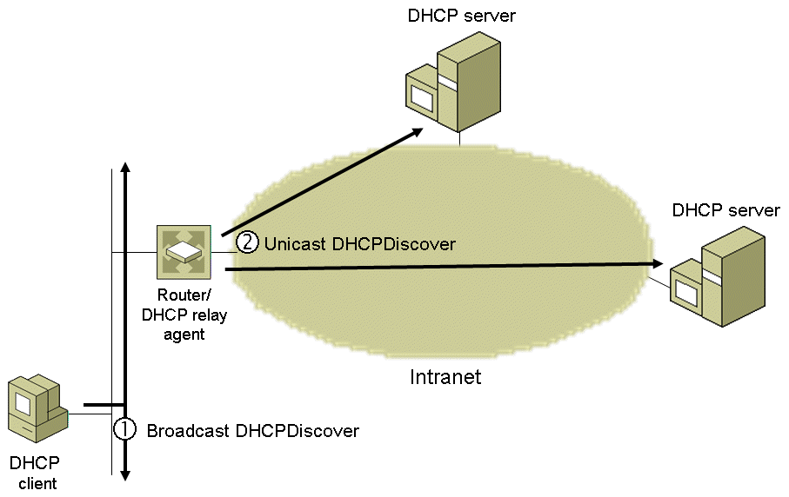
Message Flow
Initializing State

Slide 16
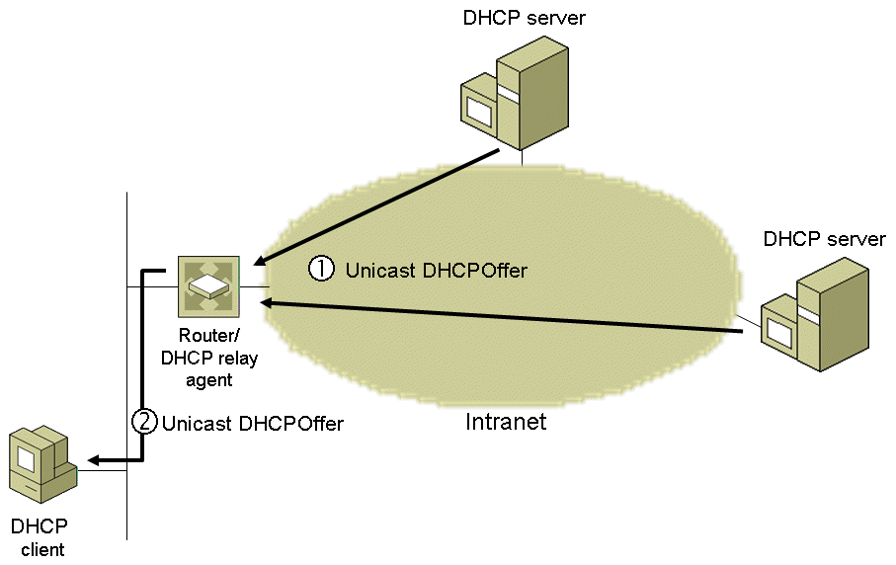
Message Flow
Selecting State

Slide 17
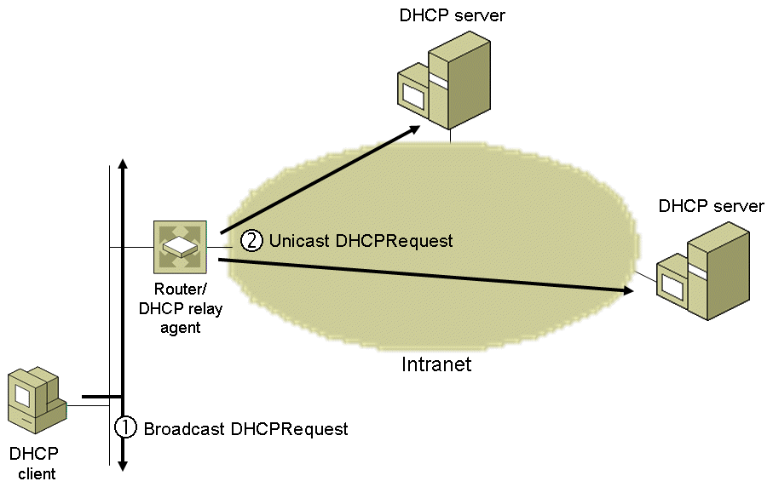
Message Flow
Requesting State

Slide 18
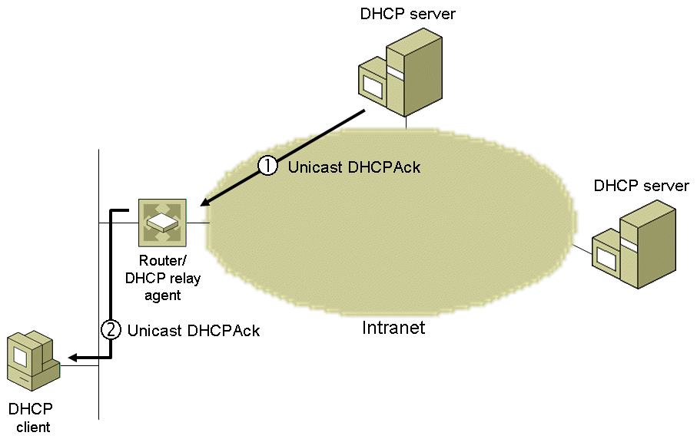
Message Flow
Bound State

Slide 19
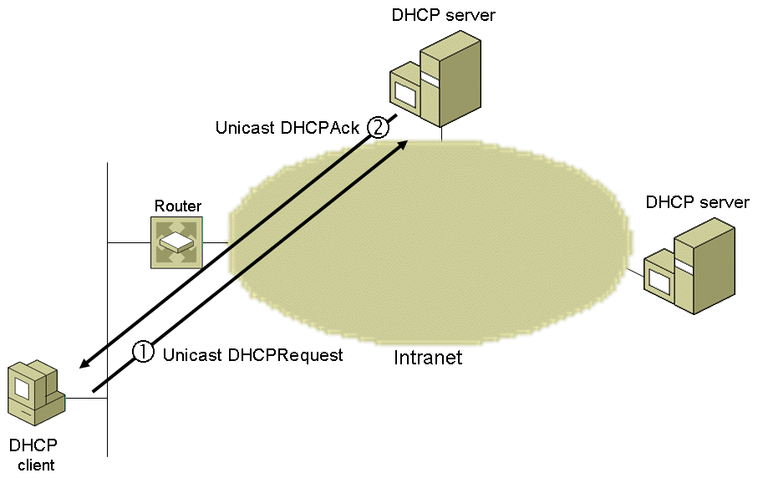
Message Flow
Renew State

Slide 20
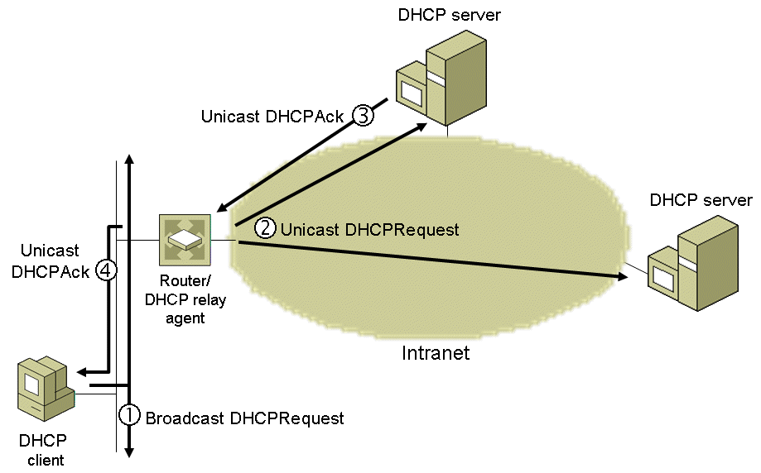
Message Flow
Rebinding State

Slide 21
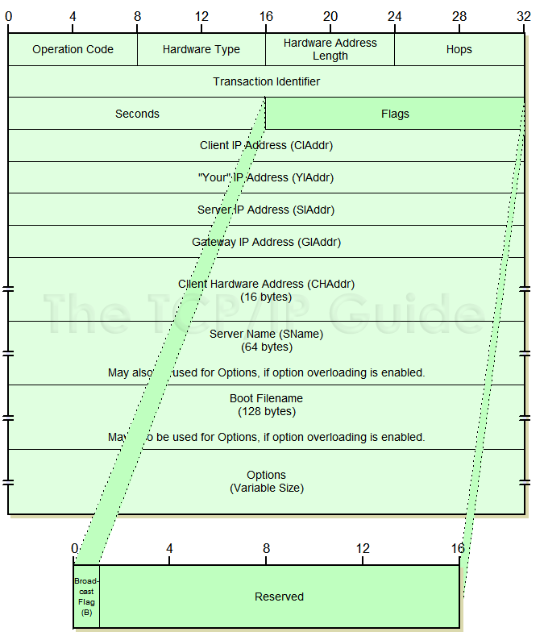
Message Flow
DHCP Message Format

Slide 22
Message Flow
Message Op Code (Op): a 1-byte field indicating whether the message is a request (set to 1) or a reply (set to 2)
Hardware Address Type (Htype): a 1-byte field indicating the type of hardware being used by the DHCP client (e.g., Ethernet, Frame Relay, ATM)
Hardware Address Length (Hlen): a 1-byte field indicating the number of high order bytes within the fixed-length Client Hardware Address field that contains the client’s hardware address (= 6 for Ethernet)
Hops: a 1-byte field indicating how many DHCP relay agents have forwarded the message. The initial value is 0.
When a DHCP relay agent forwards a DHCP message on behalf of either a DHCP client or a DHCP server, it increments this field.
The maximum number of hops in a DHCP infrastructure is 16. If the value is greater than 16, the receiving DHCP relay agent silently discards the message.
DHCP relay agents can also discard DHCP messages if this field exceeds a configurable value (e.g., Windows Server 2008 uses a default maximum of 4 hops)
Note: this field is different from the Time to Live (TTL) field in the IPv4 header

Slide 23
Message Flow
Transaction ID (Xid): a 4-byte field containing a random number derived by the DHCP client to group all of the DHCP messages of a given message exchange together
Seconds (Secs): a 2-byte field set by the DHCP client to indicate the number of seconds that have elapsed since the client began the address acquisition process (may be used by a busy DHCP server to prioritize replies when multiple client requests are outstanding.)
Flags: a 2-byte field indicating flags set by the DHCP client. RFC 2131 defines the leftmost bit as the Broadcast flag (set to 1 to indicate client cannot receive unicast IP datagrams)
Some clients cannot accept IP unicast datagrams before the TCP/IP software is configured (packets delivered to the client's hardware address is not forwarded to IP layer)
Windows Server 2008 and Windows Vista: DHCP client set the Broadcast flag to 1 (responses must be broadcast).
Windows Server 2003 and XP: DHCP client sets Broadcast flag to 0 (allows unicast responses)
By default, Windows DHCP servers ignore the Broadcast bit on the client requests (DHCP responses are sent as IP broadcasts to the limited broadcast address 255.255.255.255). To configure the DHCP Server to process the Broadcast flag, create and set the IgnoreBroadcastFlag registry value to 0

Slide 24
Message Flow
Client IP Address (Ciaddr): A 4-byte field indicating a DHCP client’s IP address,
set by the DHCP client when it has been successfully configured with the IP address (Bound, Renewing, and Rebinding states) and can respond to ARP requests to defend the use of the address.
client does not use this field to request a particular IP address in a lease; it uses the Requested IP Address option
Your IP Address (Yiaddr): a 4-byte field indicating the IP address being allocated to the DHCP client by the DHCP server
Server IP Address (Siaddr): a 4-byte field indicating the IP address of the server that the client should use for the next step in the bootstrap process (which may or may not be the server sending this reply), returned in DHCPOFFER, DHCPACK by server
The sending server always includes its own IP address in the Server Identifier option

Slide 25
Message Flow
Gateway IP Address (Giaddr): a 4-byte field indicating an IP address assigned to the interface on the initial DHCP relay agent that received the message from the DHCP client.
The initial DHCP relay agent is located on the same subnet as the DHCP client that broadcast the DHCP request message (either a DHCPDISCOVER or DHCPREQUEST message).
By recording an IP address for the subnet of the DHCP client in this field, the DHCP server can determine the proper scope from which to assign an IP address to the requesting DHCP client.
Client Hardware Address (Chaddr): a 16-byte field indicating the hardware address of the DHCP client (contains the 6-byte MAC address for Ethernet)
Server Host Name (Sname): a 64-byte field indicating a name for the DHCP server (DHCP Server in Windows Server 2008 does not use this field)

Slide 26
Message Flow
Boot File Name (File): a 128-byte field indicating the name of the file containing a boot image for a BOOTP client.
BOOTP was developed before DHCP to allow a diskless host computer to obtain an IP address configuration, the name of a boot file, and the location of a Trivial File Transfer Protocol (TFTP) server from which the computer loads the boot file.
DHCP message exchanges do not use this field.
Options: a variable-length set of fields containing DHCP options. Subnet Mask, Name Server, Hostname, Domain Name, Forward On/Off, Default IP TTL, Broadcast Address, Static Route, Ethernet Encapsulation, X Window Manager, X Window Font, DHCP Msg Type, DHCP Renewal Time, DHCP Rebinding, Time SMTP-Server, SMTP-Server, Client FQDN, Printer Name…

Slide 27
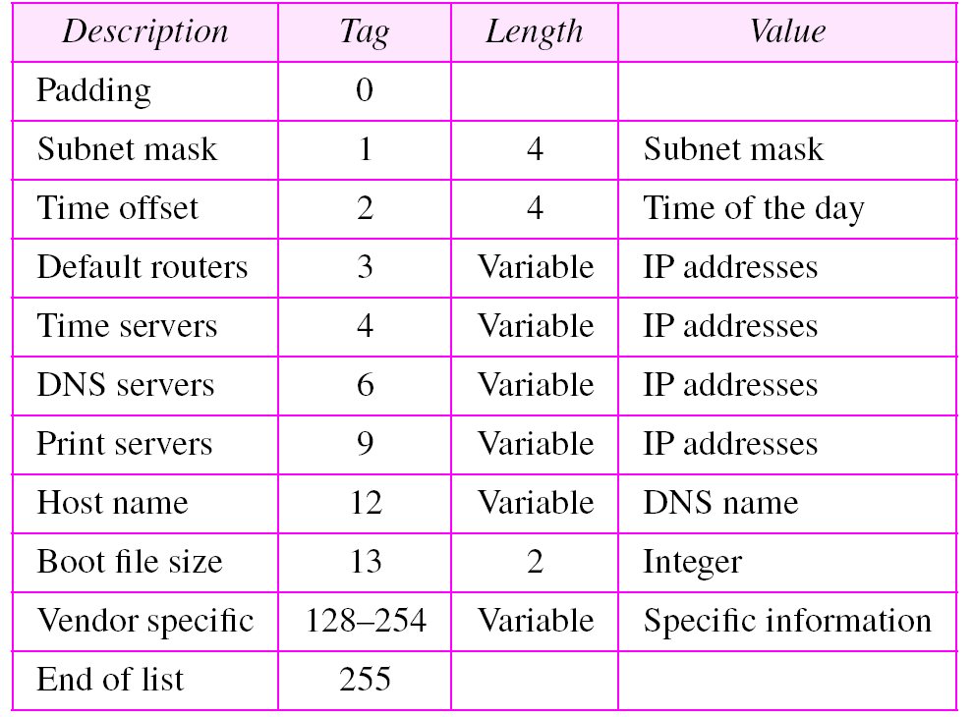
Message Flow
DHCP Option Examples
Further reference at: http://www.networksorcery.com/enp/protocol/bootp/options.htm

Slide 28
Message Flow
Fields used by DHCP clients
Field | DHCPDISCOVER, DHCPINFORM | DHCPREQUEST | DHCPDECLINE, DHCPRELEASE
'op' | BOOTREQUEST | BOOTREQUEST | BOOTREQUEST
'htype' | (from RFC) | (from RFC) | (from RFC)
'hlen' | (length in octets) | (length in octets) | (length in octets)
'hops' | 0 | 0 | 0
'xid' | selected by client | 'xid' from server DHCPOFFER message | selected by client
'secs' | 0 or seconds since DHCP process started | 0 or seconds since DHCP process started | 0
'flags' | Set 'BROADCAST' flag if client requires broadcast reply | Set 'BROADCAST' flag if client requires broadcast reply | 0
'ciaddr' | 0 (DHCPDISCOVER) or client's network address (DHCPINFORM) | 0 or client's network address (BOUND/RENEW/REBIND) | 0 (DHCPDECLINE) or client's network address (DHCPRELEASE)
'yiaddr' | 0 | 0 | 0
'siaddr' | 0 | 0 | 0
'giaddr' | 0 | 0 | 0
'chaddr' | client's hardware address | client's hardware address | client's hardware address
'sname' | options, if indicated in 'sname/file' option; otherwise unused | options, if indicated in 'sname/file' option; otherwise unused | (unused)
'file' | options, if indicated in 'sname/file' option; otherwise unused | options, if indicated in 'sname/file' option; otherwise unused | (unused)
'options' | options | options | (unused)

Slide 29
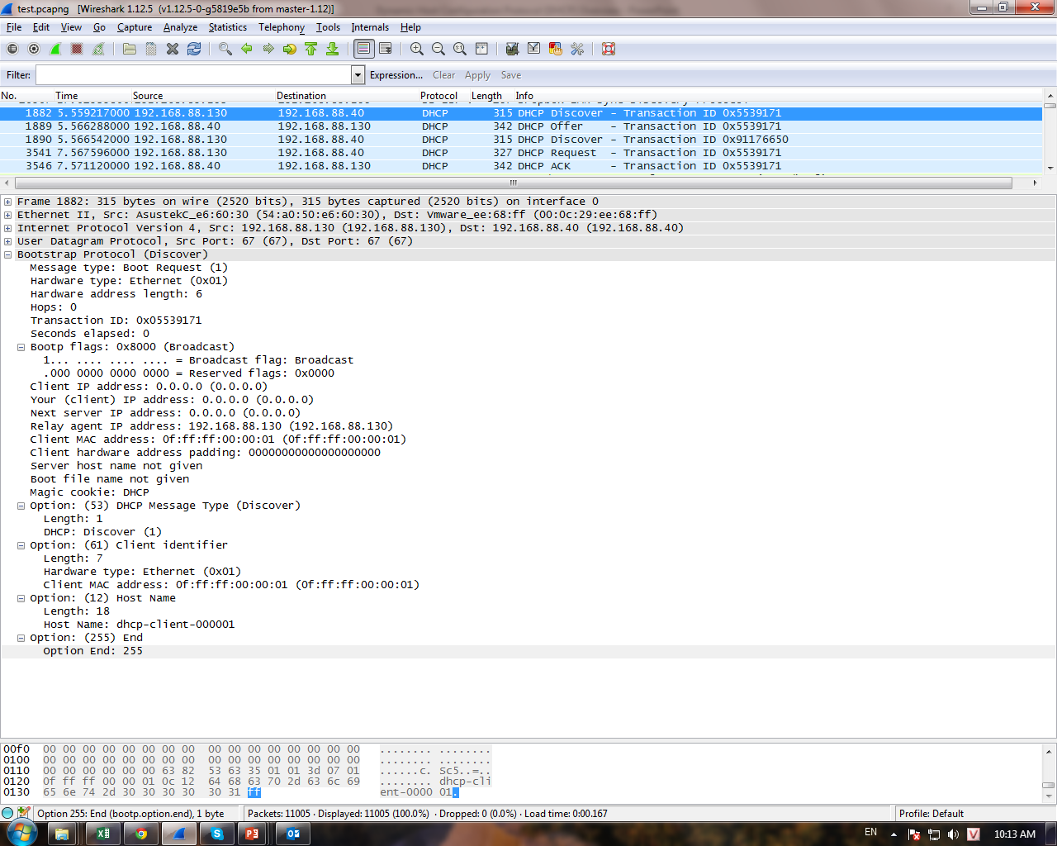

Slide 30
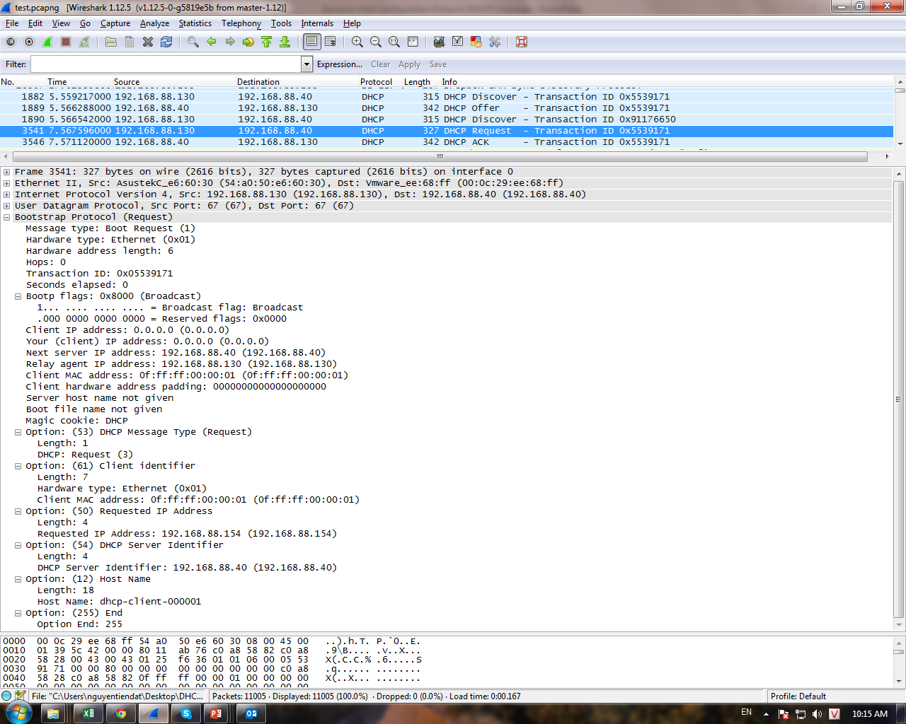

Slide 31
Initial Message Flow
Fields used by DHCP Server
Field | DHCPOFFER | DHCPACK | DHCPNAK
'op' | BOOTREPLY | BOOTREPLY | BOOTREPLY
'htype' | (from RFC) | (from RFC) | (from RFC)
'hlen' | (length in octets) | (length in octets) | (length in octets)
'hops' | 0 | 0 | 0
'xid' | 'xid' from client DHCPDISCOVER message | 'xid' from client DHCPDISCOVER message | 'xid' from client DHCPDISCOVER message
'secs' | 0 | 0 | 0
'ciaddr' | 0 | 'ciaddr' from DHCPREQUEST or 0 | 0
'yiaddr' | IP address offered to client | IP address assigned to client | 0
'siaddr' | IP address of next bootstrap server | IP address of next bootstrap server | 0
'flags' | 'flags' from client DHCPDISCOVER message | 'flags' from client DHCPREQUEST message | 'flags' from client DHCPREQUEST message
'giaddr' | 'giaddr' from client DHCPDISCOVER message | 'giaddr' from client DHCPREQUEST message | 'giaddr' from client DHCPREQUEST message
'chaddr' | 'chaddr' from client DHCPDISCOVER message | 'chaddr' from client DHCPREQUEST message | 'chaddr' from client DHCPREQUEST message
'sname' | Server host name or options | Server host name or options | (unused)
'file' | Client boot file name or options | Client boot file name or options | (unused)
'options' | options | options | (unused)

Slide 32
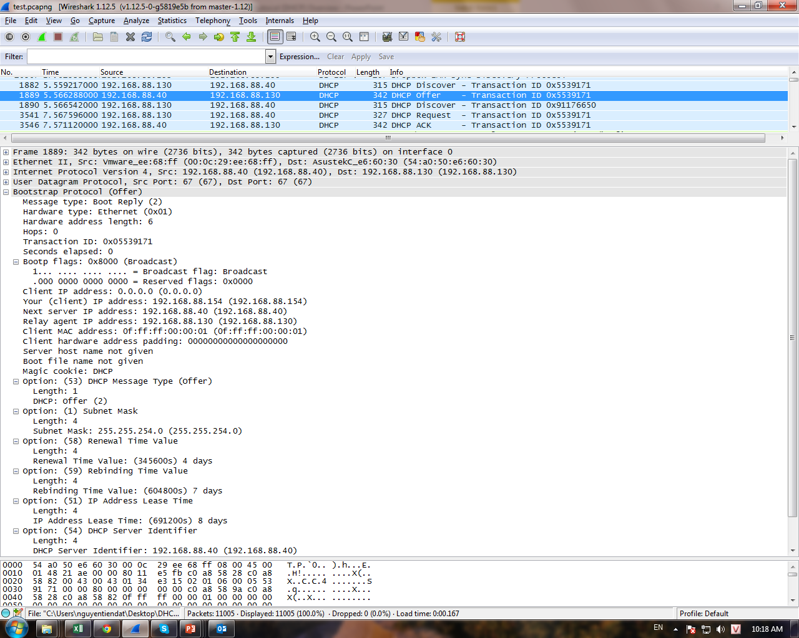

Slide 33
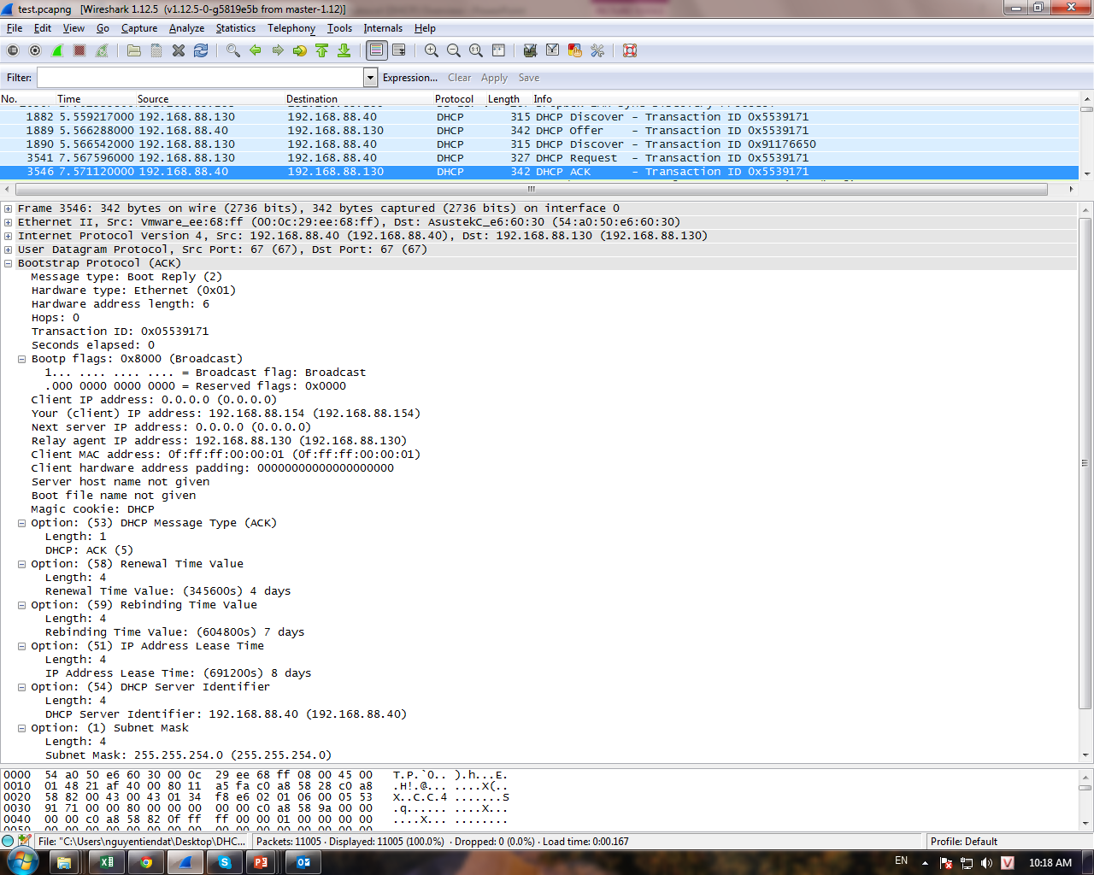

Slide 34




DHCP Relay Agents
Relay Agent within
Router
Internet
DHCP Server

Slide 35
DHCP Relay Agents
Remove restriction of having DHCP server on every network
Listen for DHCP messages and transmit them to appropriate machine
Client to server relay
Broadcast from client ® Unicast to server(s)
Server to client relay
Broadcast from server ® Broadcast to client
Unicast from server ® Unicast to client

